Slide 1

2020 Transactions Update
June 26, 2020

Slide 2

















































Focus Strategies is a premier middle-market investment bank based in Austin, Texas that serves the unique needs of privately-held businesses seeking capital or ownership transition.
2019 marked our 20th year specializing in merger and acquisition advisory, capital-raising, and strategic advisory services for established founder-owned companies. We seek to build long-term relationships with our clients based on outstanding service, integrity, and trust.
Business & Professional Services
Consumer & Retail
Energy
Engineering, Construction & Materials
Financial Services
Healthcare
Industrials, Manufacturing & Distribution
Information Technology
& Telecom

Slide 3

1
Initial 2020 Expectations

Slide 4
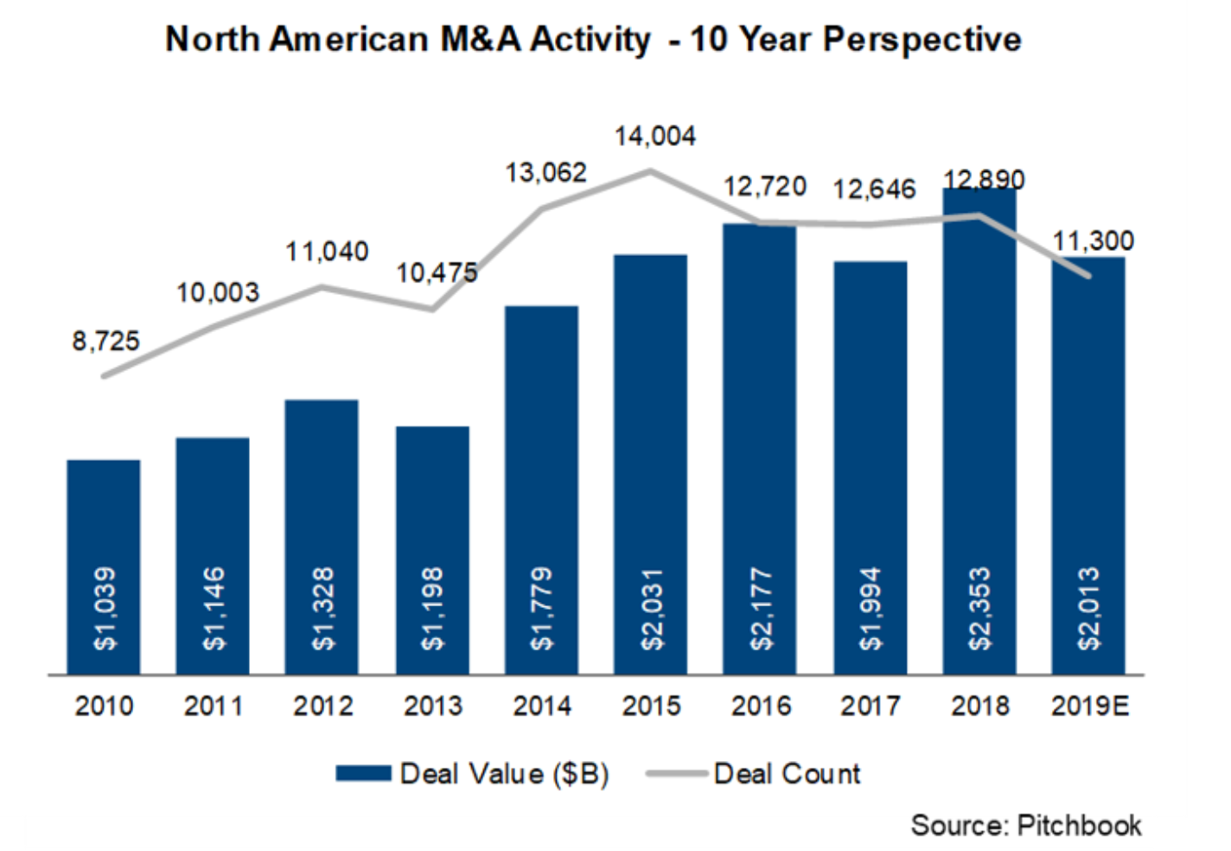
Beginning of 2020
Historic economic expansion, continuing strong transaction market
Widespread sentiment that economy was late in cycle, but no consensus on likely cause of end to expansion

Slide 5
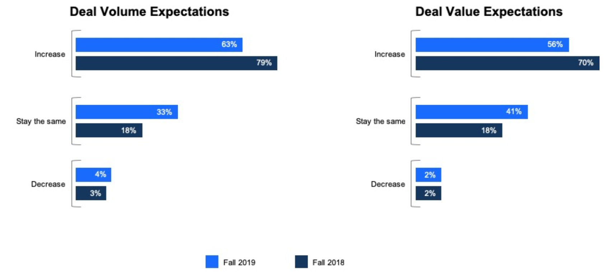
Initial 2020 Transaction Expectations
Source: Deloitte 2020 M&A Trends Survey

Slide 6
Global Private Equity – Dry Powder ($BN)
*Chart reflects most recent data available
Source: Preqin

Slide 7
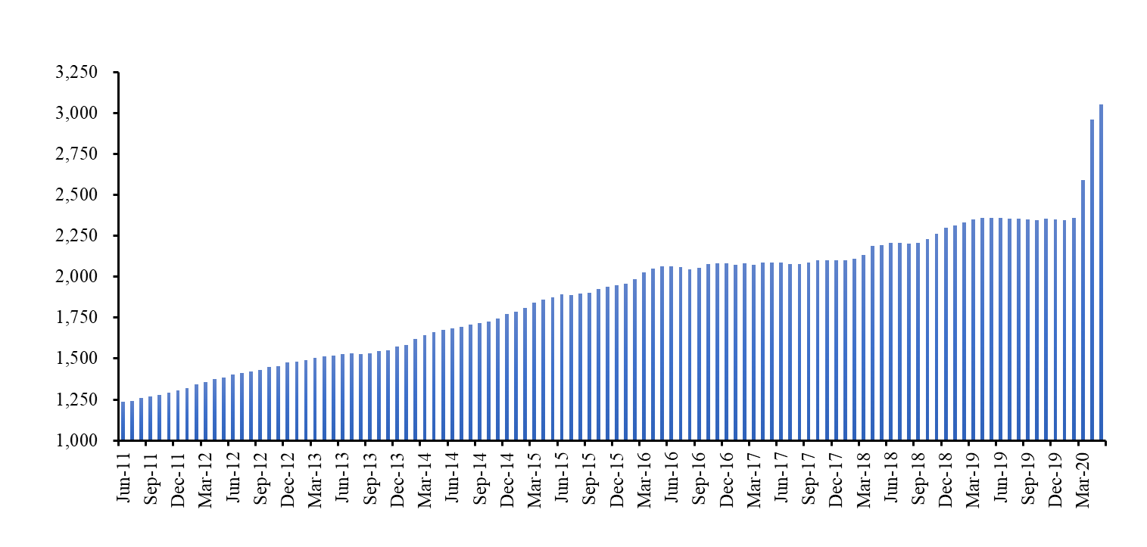
U.S. Commercial Bank Activity
U.S. Commercial and Industrial Loans Outstanding ($BN)
Source: Federal Reserve

Slide 8
2
Pandemic

Slide 9
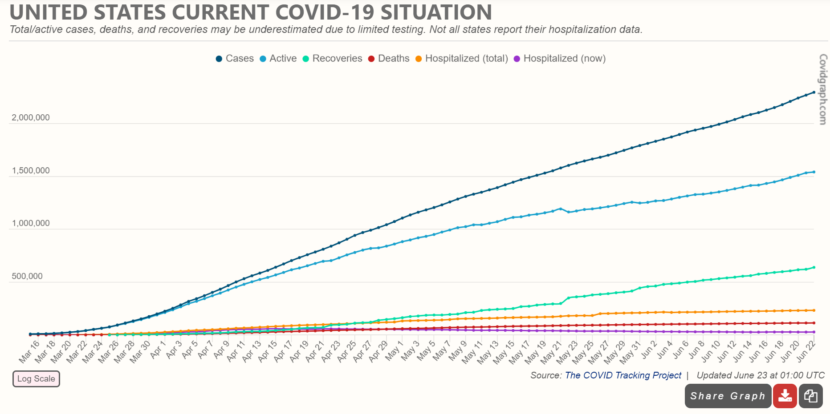
COVID-19 in U.S.

Slide 10
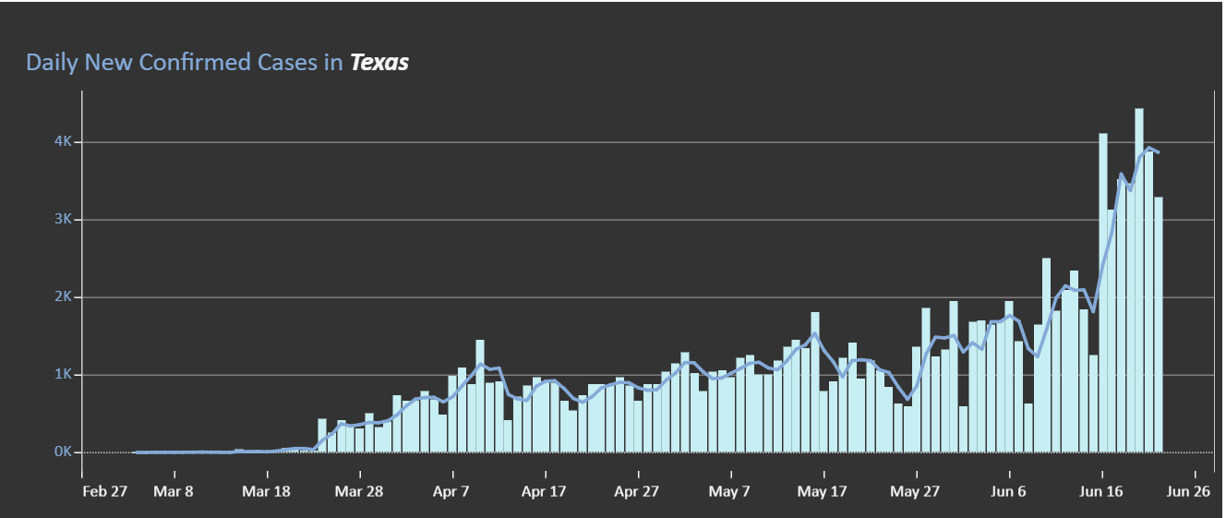
COVID-19 in Texas
Source: Texas Dept. of State Health Services

Slide 11
3
Economic Effects of Pandemic

Slide 12
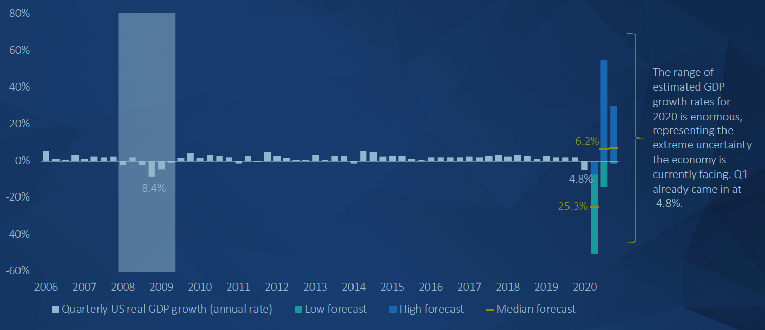
U.S. GDP growth
Source: PitchBook / WSJ Survey

Slide 13
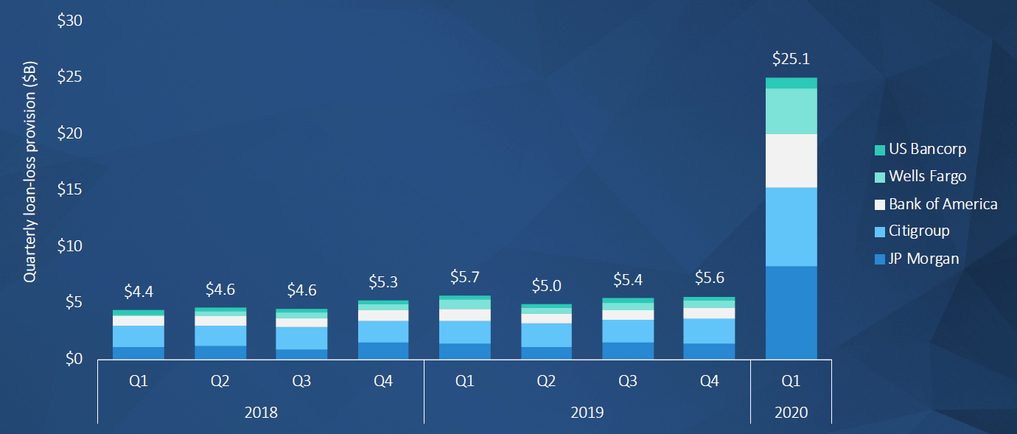
Quarterly loss reserves – largest U.S. banks
Source: PitchBook

Slide 14
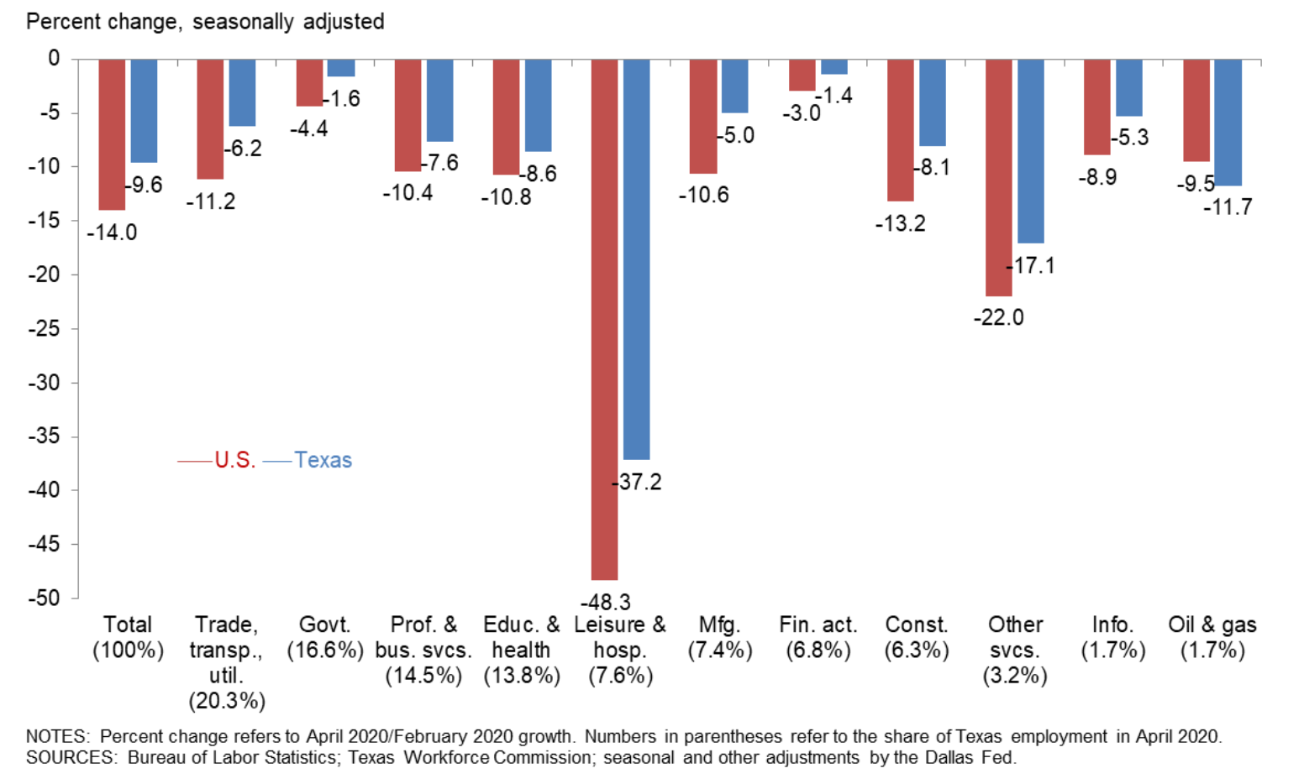
Texas v. U.S. Job Losses – Feb. to Apr. 2020
Source: Federal Reserve Bank Dallas

Slide 15
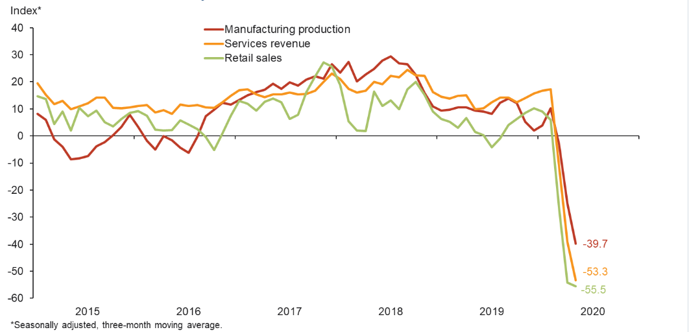
Texas Business Outlook
Source: Dallas Fed Texas Outlook Surveys

Slide 16
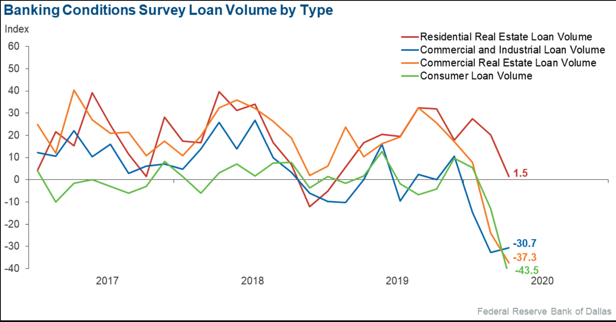
Texas Loan Volume by Type
Source: Federal Reserve Bank of Dallas
Banking Conditions Survey May 2020

Slide 17
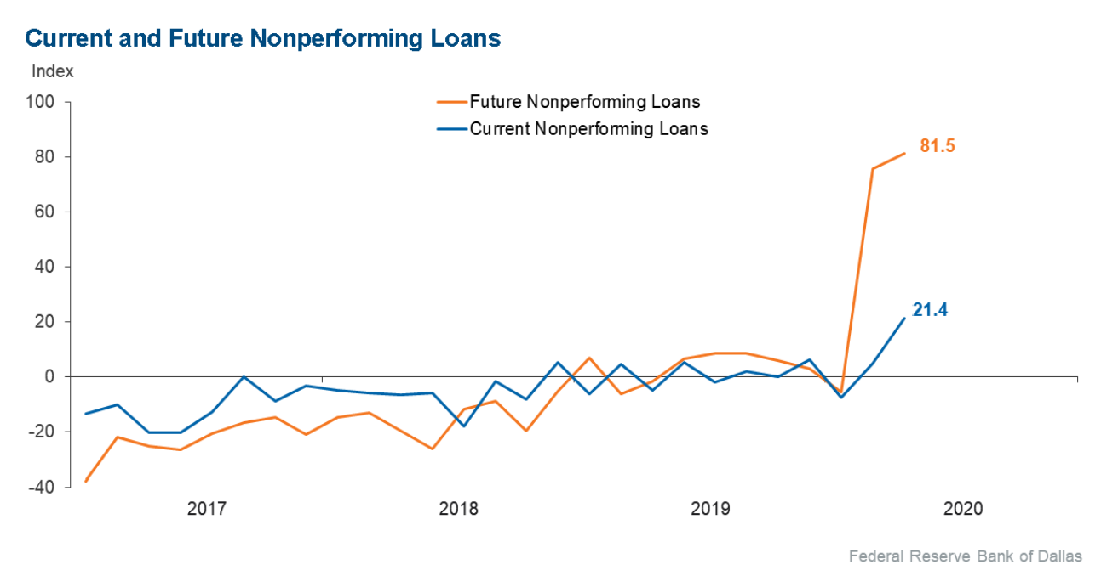
Texas Nonperforming Loans

Slide 18
4
Middle Market Trends through Q1 2020

Slide 19
Valuation Trends – U.S. Middle Market
Historical TEV*/ Revenues
Average = 1.52x
*TEV = Total Enterprise Value = Company Equity + Debt - Cash
Source: GF Data Resources

Slide 20
Valuation Trends – U.S. Middle Market
Historical TEV*/ EBITDA By Deal Size
*TEV = Total Enterprise Value = Company Equity + Debt - Cash
Source: GF Data Resources

Slide 21
Valuation Trends – U.S. Middle Market
Historical TEV*/ EBITDA By Industry
*TEV = Total Enterprise Value = Company Equity + Debt - Cash
Source: GF Data Resources

Slide 22
Debt Trends – U.S. Middle Market
Total Debt / EBITDA – All Industries by Deal Size
*TEV = Total Enterprise Value = Company Equity + Debt - Cash
Source: GF Data Resources

Slide 23
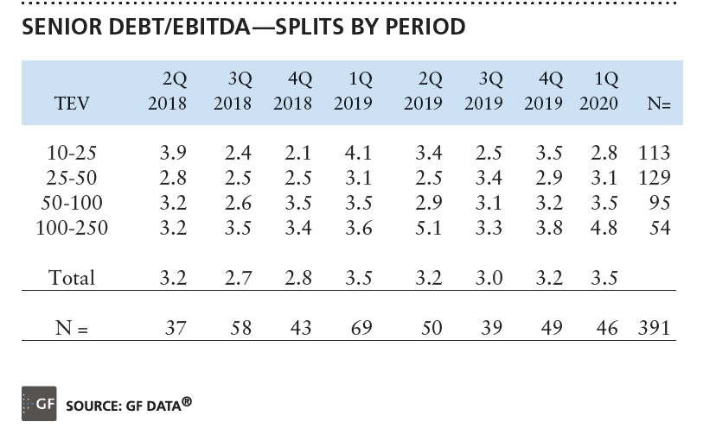
Senior Debt/EBITDA by Deal Size

Slide 24
Debt Trends – U.S. Middle Market
Source: GF Data Resources

Slide 25
Debt Trends – U.S. Middle Market
Equity and Debt Contributions
Source: GF Data Resources

Slide 26
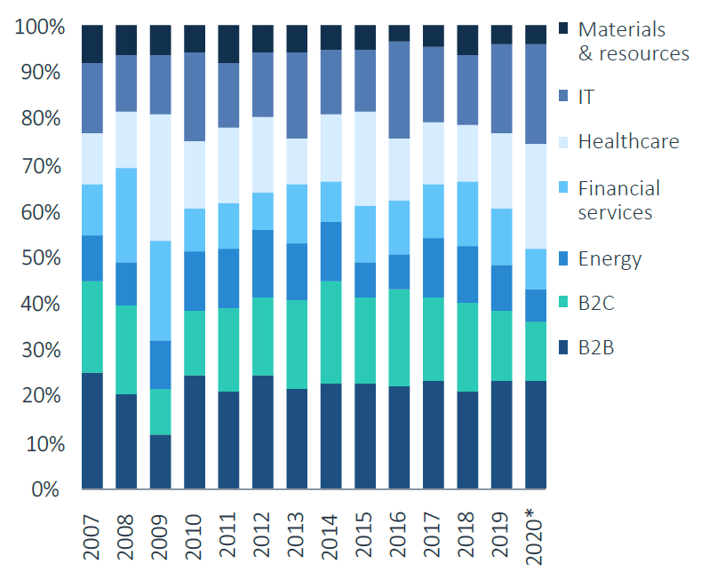
M&A ($) by sector
* To 3/31/20
Source: PitchBook

Slide 27
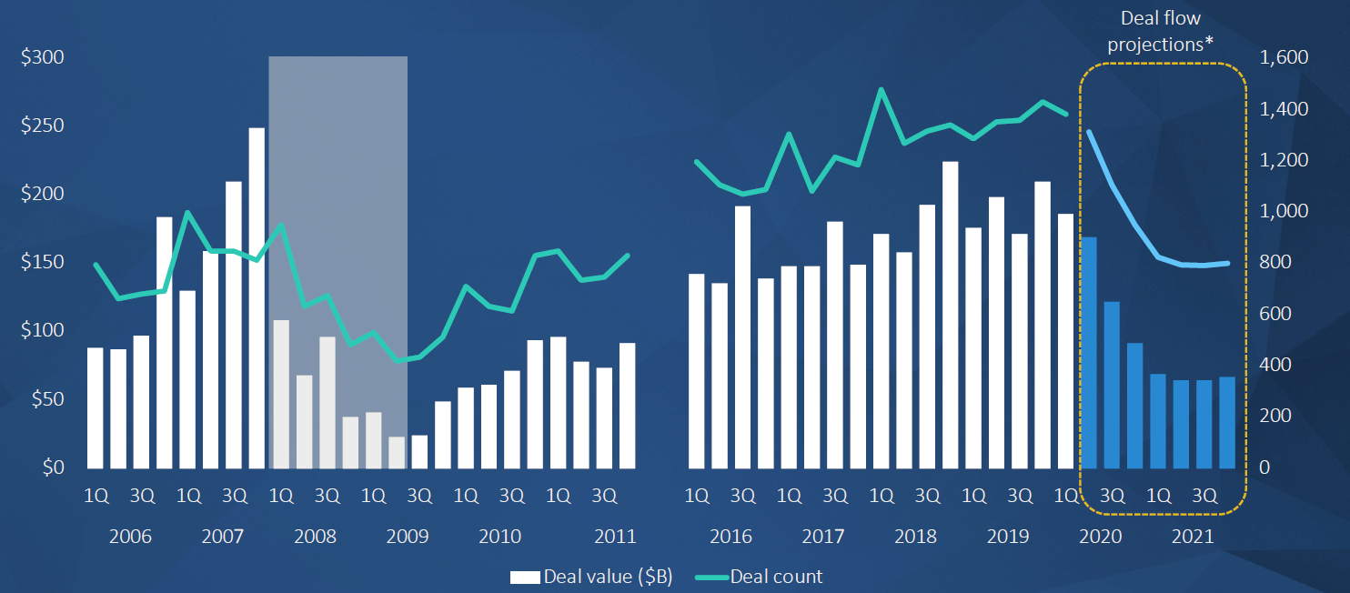
Historical and Projected PE Deal Flow
Source: PitchBook

Slide 28
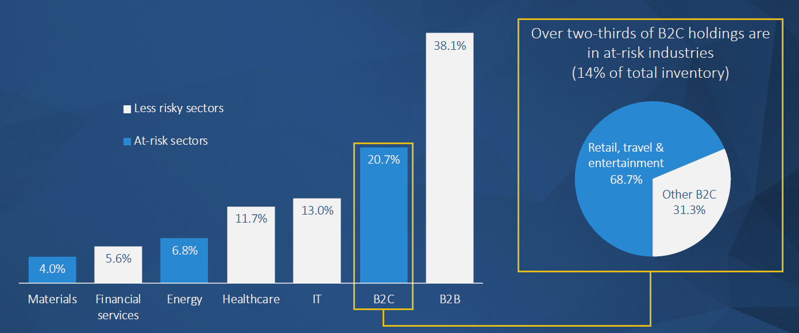
PE Holdings in At-Risk Industries
Source: PitchBook

Slide 29
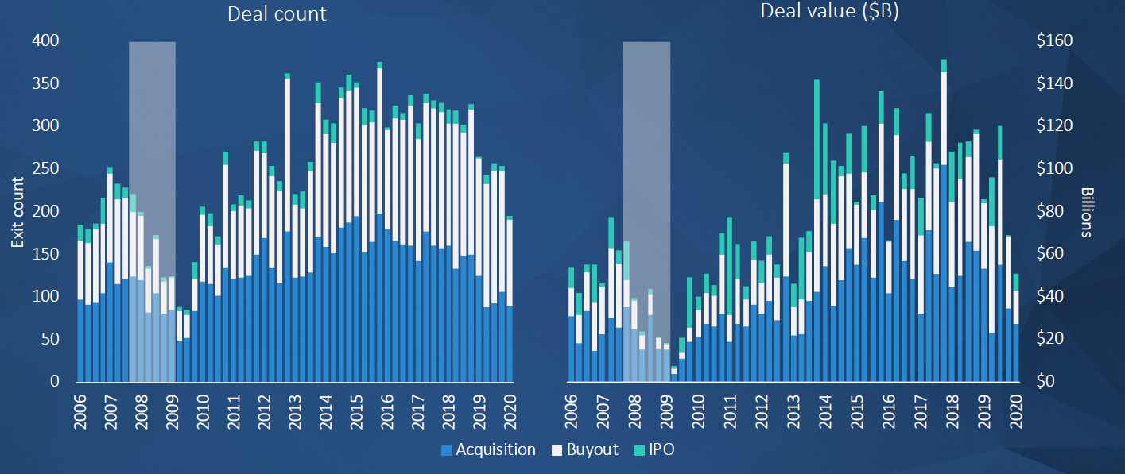
US PE Exits
Source: PitchBook

Slide 30
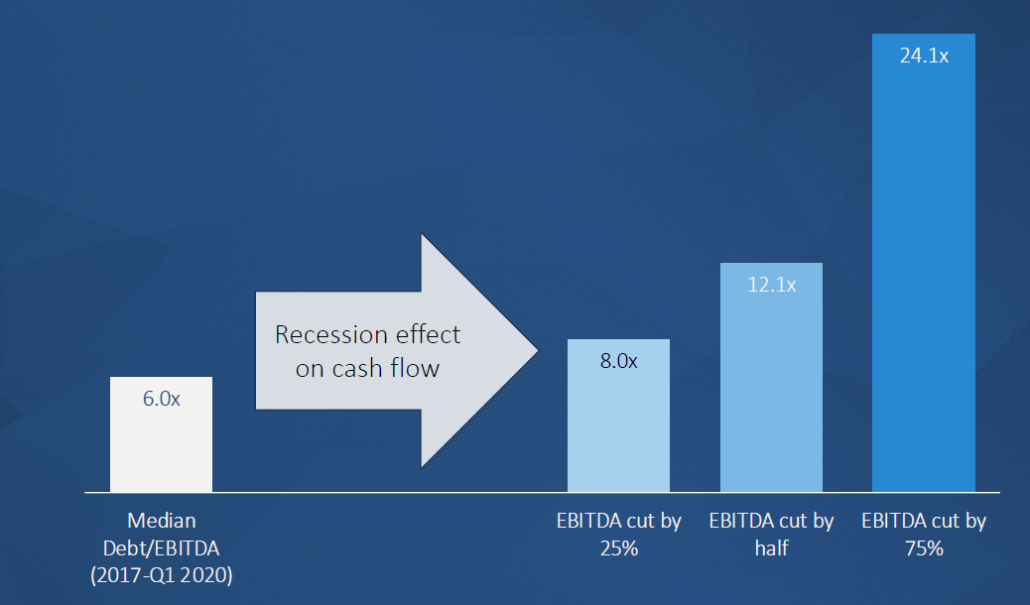
Recession Effect on Debt/EBITDA Multiples
Source: PitchBook

Slide 31
Observations / Trends
Continuation of slow transaction market at least into 3rd quarter due to COVID-related uncertainty and risk
Continued high demand and premium pricing for platform-quality companies due to amount of capital at PE firms
Tightening of debt market for private companies and for acquisitions
  EBITDA multiples for senior debt reduced 0.5 to 1.0x
  Softening of average transaction multiples
  Continued premium pricing for platforms
  Lower pricing or more buyer-favorable terms for add-ons
Conservative lending policies, higher pricing for senior debt
Increased demand for mezzanine debt, higher priced than senior debt but less dilutive than equity capital
Widening bid-ask spreads for private company acquisitions
Owners will in many cases elect to continue operating and wait for prices to firm up vs. selling in near term
Renegotiations of debt covenants for operating companies
Negotiations with landlords; increasing frequency of working from home
Substitution of web conferences for physical travel
Increasing opportunities for acquisitions in non-traditional contexts, such as in non-bankruptcy workouts and from bankruptcies
“Loan to own” strategy – nonbank lenders providing secured debt or purchasing distressed debt with view to acquire control of assets
Increasing instances of “opportunity funds” being raised to pursue transaction opportunities in various market segments, particularly travel, hospitality, entertainment, specific real estate contexts.

Slide 32
5
More about Focus Strategies

Slide 33
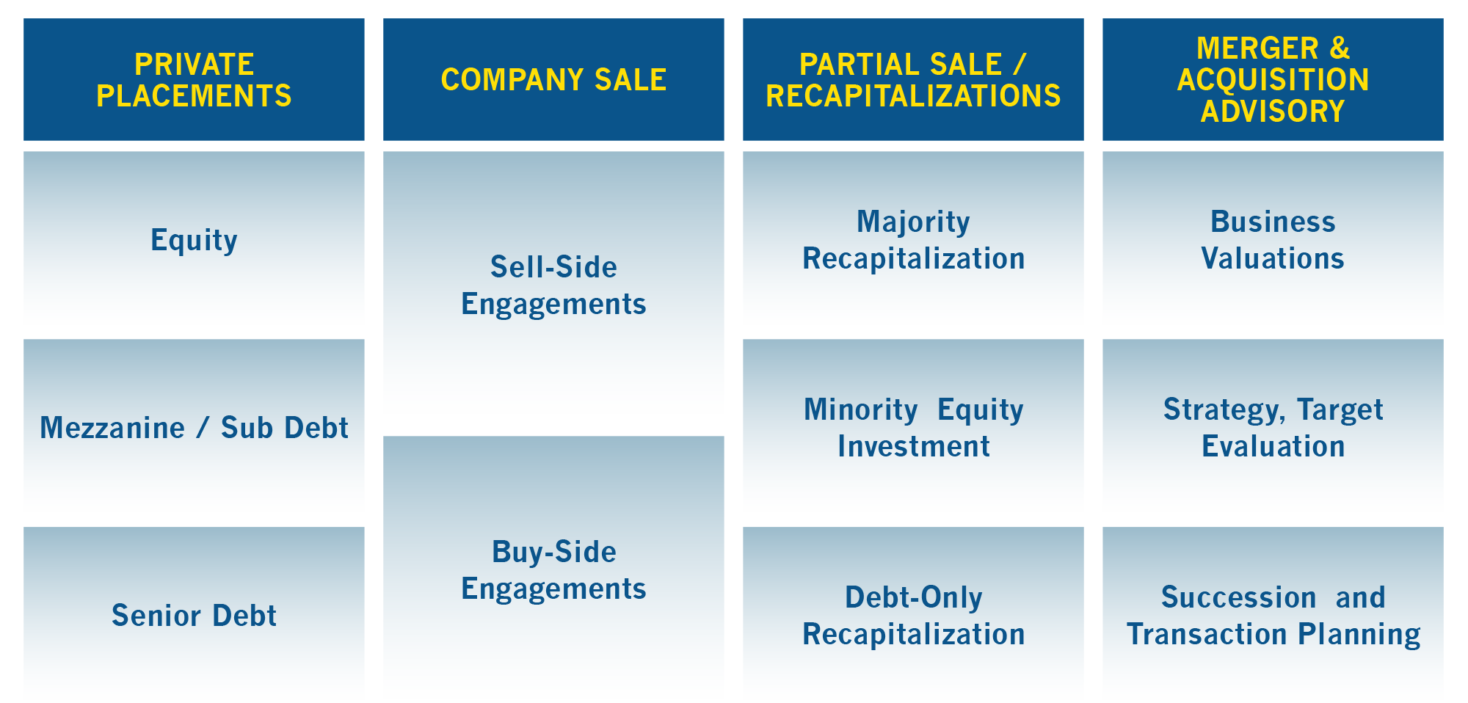
Our Services

Slide 34








Focus Strategies Uniquely Qualified
Team Deal Experience
Client-Focused Approach
Business Acumen
Over 150 deals worth more than $7B in total transaction value.
Every deal gets a team of Managing Directors and full firm support.
Exclusively focused on the client’s needs
No conflicts of interest
Local support, international contacts, vast experience
Each Managing Director has significant operating experience
100+ years of deal negotiation and closing experience
All MDs have 20+ years of leadership experience across multiple industries and functions.
Deutsche Bank
J.P. Morgan Chase
Deloitte
Halliburton
Teledyne Technologies
Emerson Electric
PaineWebber
Focused on Maximizing Shareholder Value

Slide 35





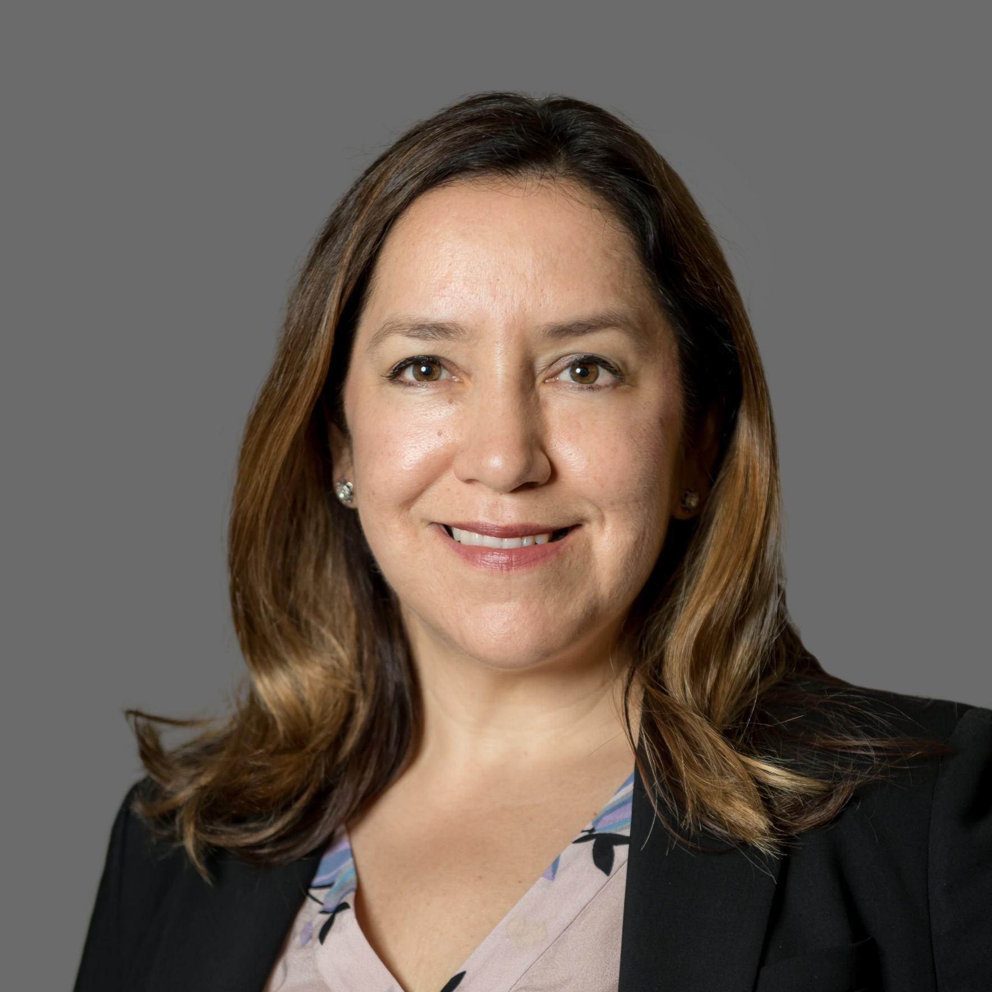







Focus Strategies Team
President
Managing Directors
Directors
F. Gary Valdez
Founder, President
gvaldez@focus-strategies.com
(512) 477-3280 ext. 14
Britt Kauffman
Managing Director
bkauffman@focus-strategies.com
(512) 477-3280 ext. 20
Larry Hester, PE
Managing Director
lhester@focus-strategies.com
(512) 477-3280 ext. 16
Oliver Sandlin
Managing Director
osandlin@focus-strategies.com
(512) 477-3280 ext. 17
Steve Reesing
Director
sreesing@focus-strategies.com
(512) 477-3280 ext. 15
Terese Everson
Director
teverson@focus-strategies.com
(512) 477-3280 ext. 23
Vice Presidents
Advisors
Focus Strategies, LLC d/b/a
Focus Strategies Investment Banking
901 S. Mopac Expressway
Building II, Suite 350
Austin, TX 78746
512-477-3280 Tel 512-391-1876 Fax
www.focus-strategies.com
Securities offered through Focus Strategies Merchant Banking, LLC, a member of FINRA and SIPC
John Pruitt
Vice President
jpruitt@focus-strategies.com
(512) 477-3280 ext. 11
Lauren V. Greenwood
Vice President
lgreenwood@focus-strategies.com
(512) 477-3280 ext. 21
John Biggs
Advisor
jbiggs@focus-strategies.com
Associates
Joe Denham
Associate
jdenham@focus-strategies.com
(512) 477-3280 ext. 24
Shepherd Robinson
Associate
srobinson@focus-strategies.com
(512) 477-3280 ext. 27
Corey Jackel
Associate
cjackel@focus-strategies.com
(512) 477-3280 ext. 26

